Slide 1
Stack Data Structure
Important

Slide 2
Stack
A stack is a linear data structure that can be accessed only at one of its ends for storing and retrieving data.
Such a stack resembles a stack of trays in a cafeteria: new trays are put on the top of the stack and taken off the top.
The last tray put on the stack is the first tray removed from the stack. For this reason, a stack is called an LIFO structure: last in/first out.

Slide 3
Stack
A tray can be taken only if there is at least one tray on the stack, and a tray can be added to the stack only if there is enough room; that is, if the stack is not too high.
Therefore, a stack is defined in terms of operations that change its status and operations that check this status.

Slide 4
Operations on Stack
■ clear()—Clear the stack.
■ isEmpty()—Check to see if the stack is empty.
■ push(el)—Put the element el on the top of the stack.
■ pop()—Take the topmost element from the stack.
■ topEl()—Return the topmost element in the stack without removing it.

Slide 5
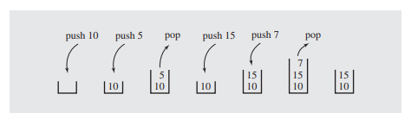
Stack Working
A series of push and pop operations is shown in Figure
Notes:
After pushing number 10 onto an empty stack, the stack contains only this number. After pushing 5 on the stack, the number is placed on top of 10 so that, when the popping operation is executed, 5 is removed from the stack, because it arrived after 10, and 10 is left on the stack. After pushing 15 and then 7, the topmost element is 7, and this number is removed when executing the popping operation, after which the stack contains 10 at the bottom and 15 above it.

Slide 6
Stack Importance
Generally, the stack is very useful in situations when data have to be stored and then retrieved in reverse order.
One application of the stack is in matching delimiters in a program. This is an important example because delimiter matching is part of any compiler: No program is considered correct if the delimiters are mismatched.

Slide 7

C++ Delimiters
In C++ programs, we have the following delimiters: parentheses “(” and “)”, square brackets “[” and “]”, curly brackets “{” and “}”, and comment delimiters “/*” and “ */”. Here are examples of C++ statements that use delimiters properly:

Slide 8
C++ Delimiters in which error is possible
a = b + (c - d) * (e - f));
g[10] = h[i[9]] + j + k) * l;
while (m < (n[8) + o]) { p = 7; /* initialize p */ r = 6; }
the first opening parenthesis must be matched with the last closing parenthesis, but this is done only after the second opening parenthesis is matched with the next to last closing parenthesis; this, in turn, is done after the opening square bracket is matched with the closing bracket.

Slide 9
Stack Application for Delimeter
The delimiter matching algorithm reads a character from a C++ program and stores it on a stack if it is an opening delimiter.
If a closing delimiter is found, the delimiter is compared to a delimiter popped off the stack. If they match, processing continues; if not, processing discontinues by signaling an error.
The processing of the C++ program ends successfully after the end of the program is reached and the stack is empty. Here is the algorithm:

Slide 10
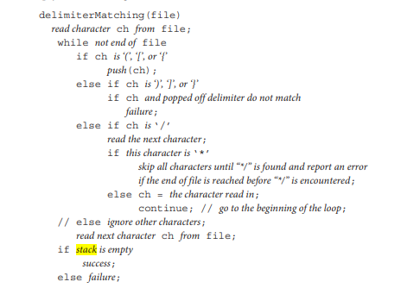

Slide 11
Explanation of Algorithm
This algorithm is like a game where you have to check if all the parentheses ( () ), square brackets ( [] ), and curly braces ( {} ) in a file are matched correctly.
Read a Character from the File: Start by reading the first character from the file.
Loop Through the Characters:
Keep doing the following steps until you reach the end of the file:
If it's an Opening Parenthesis, Bracket, or Brace:
If the character is (, [, or {, put it on a stack (like putting it in a pile).

Slide 12
Explanation of Algo
If it's a Closing Parenthesis, Bracket, or Brace:
If the character is ), ], or }, check if it matches the last opening delimiter on the stack.
If they match, it's good! Take them both off the stack.
If they don't match, something went wrong. It's like having an extra closing bracket with no opening one. We call it a "failure."
If it's a Slash (/):
Read the next character.
If the next character is an asterisk (), it means we've found the start of a comment (/). So, we need to ignore everything until we find the end of the comment (*/). If we reach the end of the file before finding */, report an error.
Otherwise:
Ignore any other characters.
Read the Next Character:
Move to the next character in the file.

Slide 13
Explanation of Algo
Check for Success or Failure:
After going through all the characters in the file, if there are no leftovers on the stack (all opening delimiters found their matching closing ones), then it's a "success." Otherwise, if there are still some opening delimiters left on the stack, it's a "failure."

Slide 14
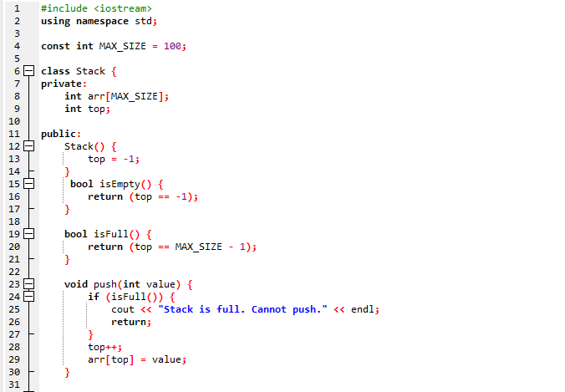

Slide 15
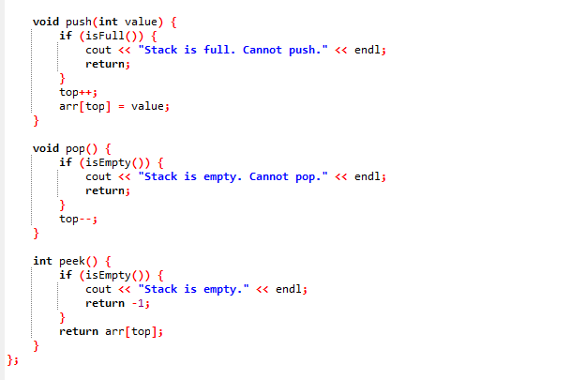

Slide 16
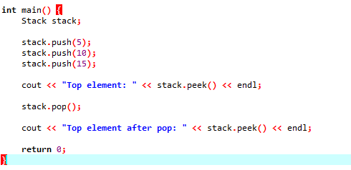

Slide 17
Why -1 in functions?
In the Stack class, top is an integer variable that keeps track of the index of the top element in the stack. It's initialized to -1 to indicate that the stack is initially empty. When you add an element, top will be incremented to 0, and so on
isEmpty Function:this function checks whether the stack is empty. If top is -1, it means the stack is empty, so the function returns true. Otherwise, it returns false
isFull Function: This function checks whether the stack is full. If top is equal to MAX_SIZE - 1, it means the stack is full, so the function returns true. Otherwise, it returns false
peek Function: In this function, if you try to peek at the top element when the stack is empty (which is not allowed), it prints a message and returns -1 to indicate that there's no valid value to return.

